Slide 1
Bài 1
Git - Images

Slide 2
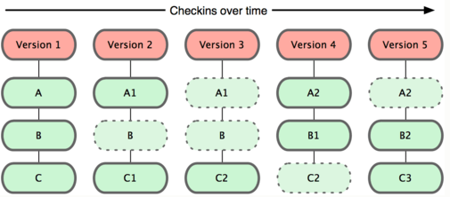

Slide 3
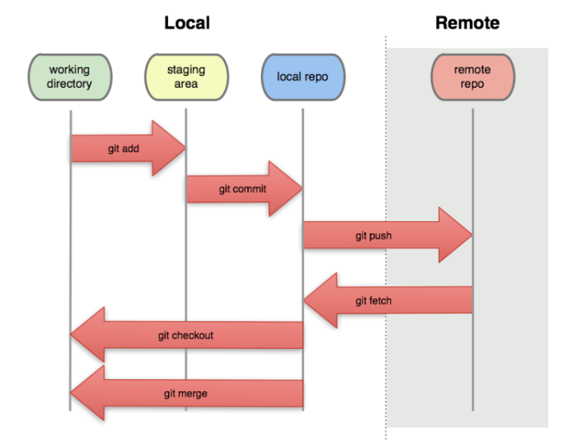

Slide 4
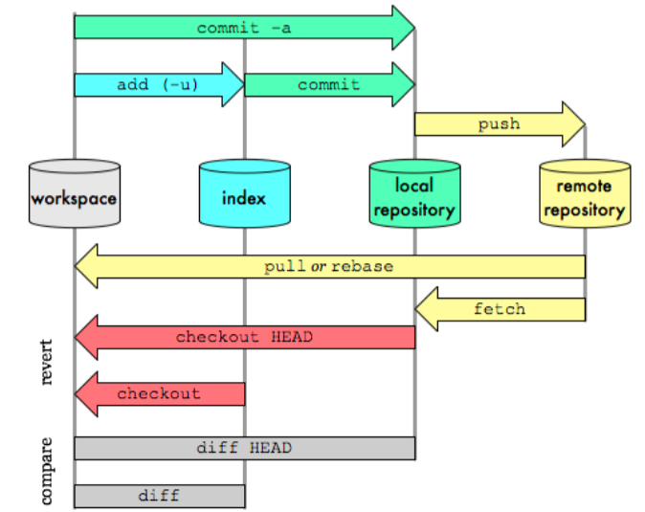

Slide 5
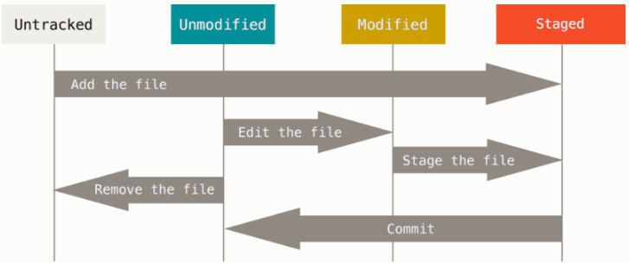
GIT’S FILES STATUS

Slide 6
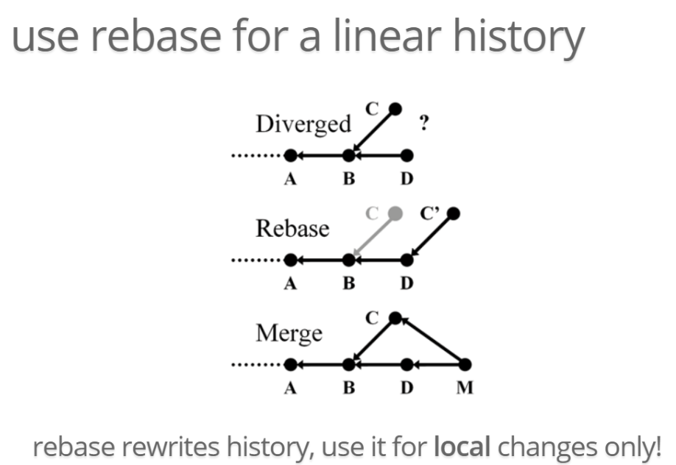
Notes:
http://aht.github.io/whatisgit/#/rebase

Slide 7
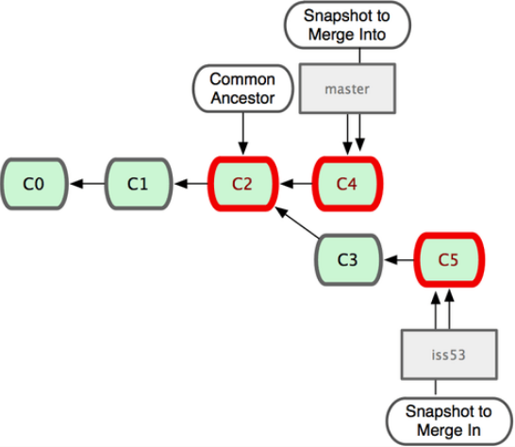
Notes:
http://aht.github.io/whatisgit/#/rebase

Slide 8
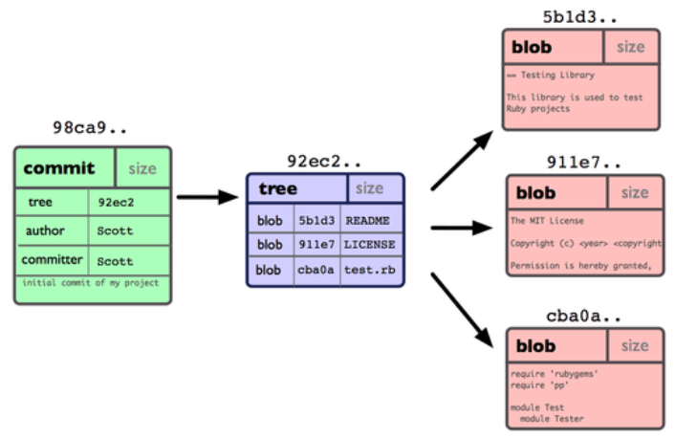
Notes:
http://aht.github.io/whatisgit/#/rebase

Slide 9
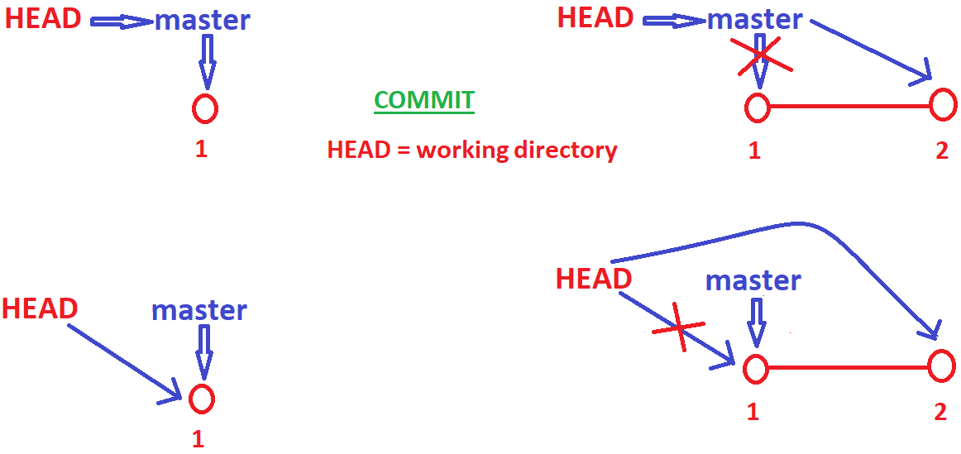
Notes:
http://aht.github.io/whatisgit/#/rebase

Slide 10
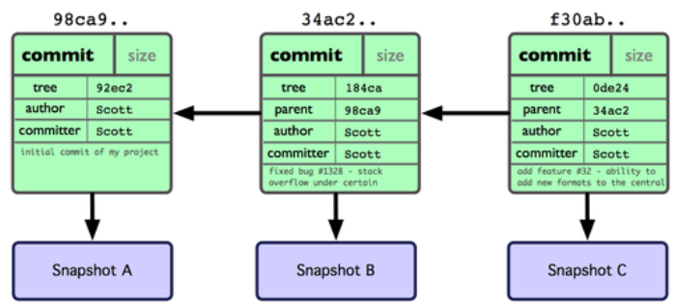
Notes:
http://aht.github.io/whatisgit/#/rebase

Slide 11


END

